Slide 1

Asynchronous JavaScript
Aris Markogiannakis
City University - Short Courses
CS3606 : JavaScript 2: Advanced Javascript for Websites and Web

Slide 2
This week?
This week we will learn about:
pararell vs async
callbacks
async/wait
promises
generators
Notes:
Read this...
https://blog.bitsrc.io/understanding-asynchronous-javascript-the-event-loop-74cd408419ff
https://blog.sessionstack.com/how-javascript-works-event-loop-and-the-rise-of-async-programming-5-ways-to-better-coding-with-2f077c4438b5
https://medium.freecodecamp.org/javascript-from-callbacks-to-async-await-1cc090ddad99

Slide 3
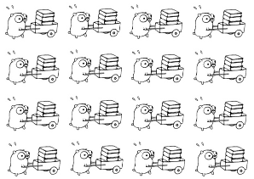
Parallel vs Async
Parallel computing is a type of computation which many calculations or the execution of processes are carried out simultaneously
Parallel needs multiple threads and needs optimisation to make sure that all tasks are done at a certain time and events are synchronised.
The best example of parallel computing is our OS - Operating System.
Async programming is running on a single thread event system works by placing events in a queue and processing them one-by-one calling the appropriate event handler. The event handler runs until it completes when it returns control to the dispatcher which deals with the next event in the queue.
This is an asynchronous system because you cannot say exactly when anything is going to happen.
There is no set order that your code will execute in. It all depends to what the user clicks on the UI.

Slide 4
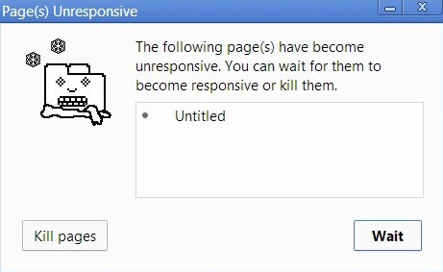
Browser got stack!
Imagine a complex image transformation algorithm that’s running on your browser.
While the Call Stack has functions to execute, the browser can’t do anything else it’s being blocked.
You get this window to pop-up

Slide 5
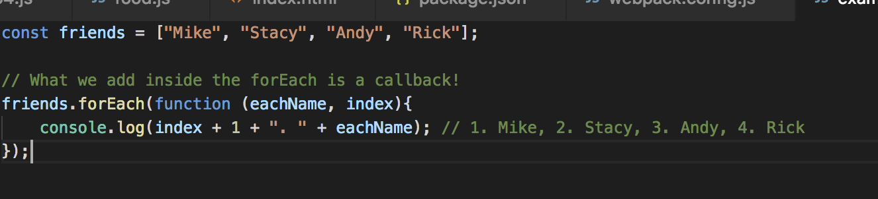
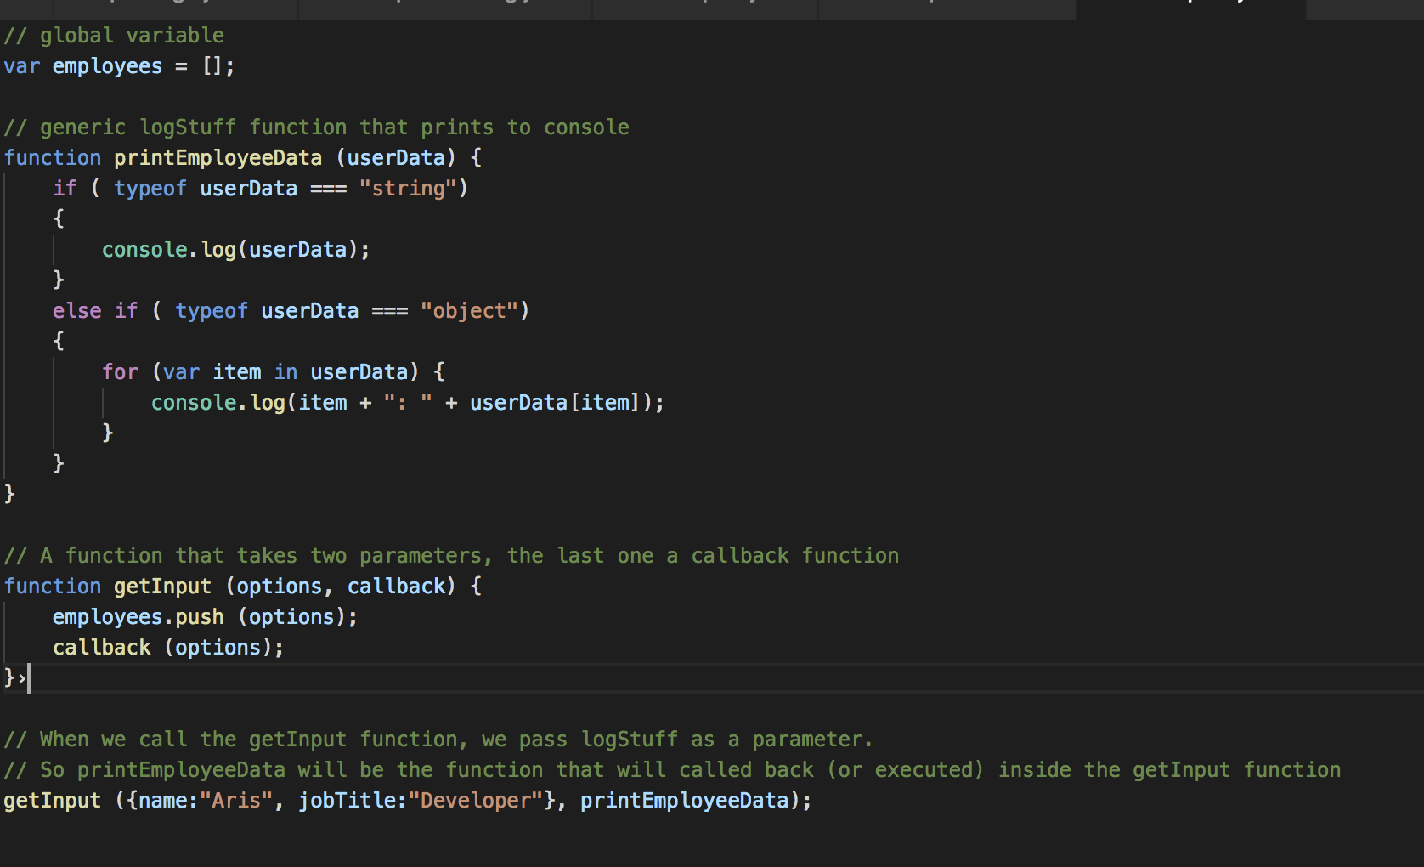
Callbacks
Asynchronous programming can only be achieved in JavaScript with functions being first-class citizens of the language.
We pass those functions as any other variable to other functions a.k.a high order functions
No return values - only calling another function with the values
Let’s take a look inside the example to the right
Notes:
https://blog.risingstack.com/asynchronous-javascript/
https://blog.sessionstack.com/how-javascript-works-event-loop-and-the-rise-of-async-programming-5-ways-to-better-coding-with-2f077c4438b5

Slide 6
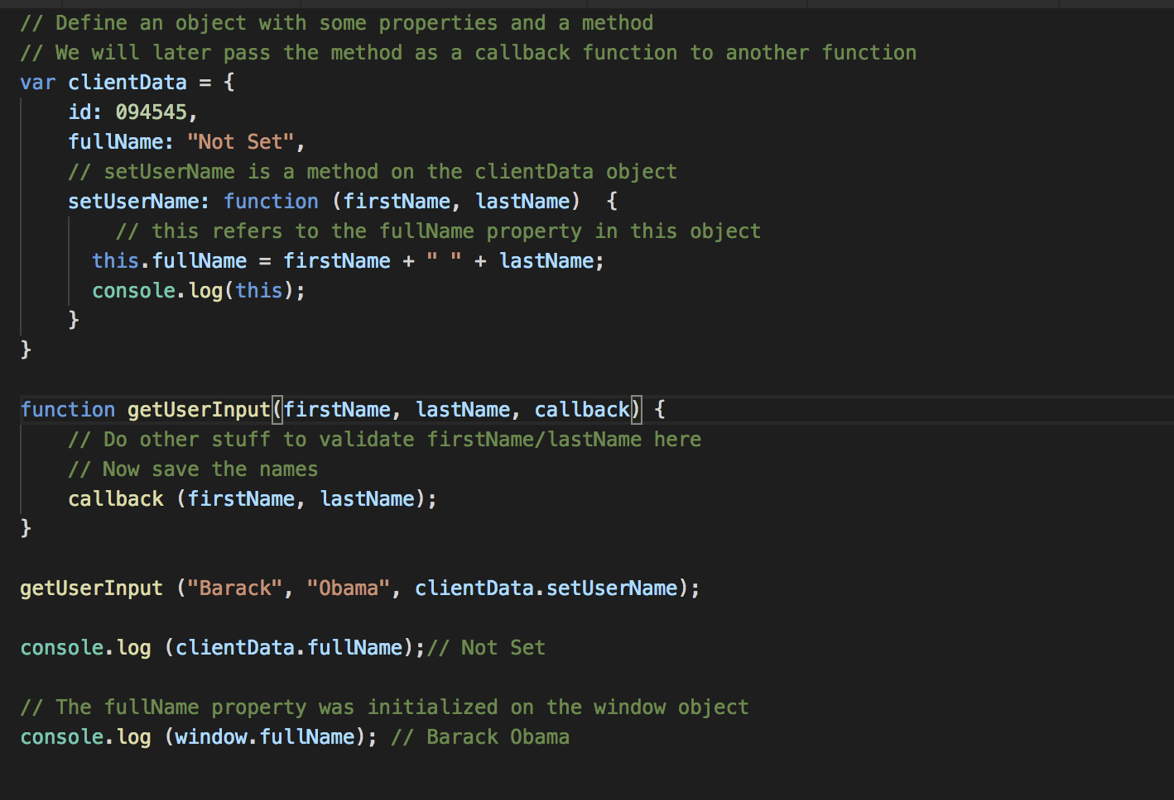
Callbacks and this
If we take a look on the example on the right when we execute the getUserInput method
This.fullName will not set the fullName property on the clientData object. Instead, it will set fullName on the window object, since getUserInput is a global function.
To solve this we will need to use
callback.apply (callbackObj, [firstName, lastName]);
Notes:
http://javascriptissexy.com/understand-javascript-callback-functions-and-use-them/

Slide 7
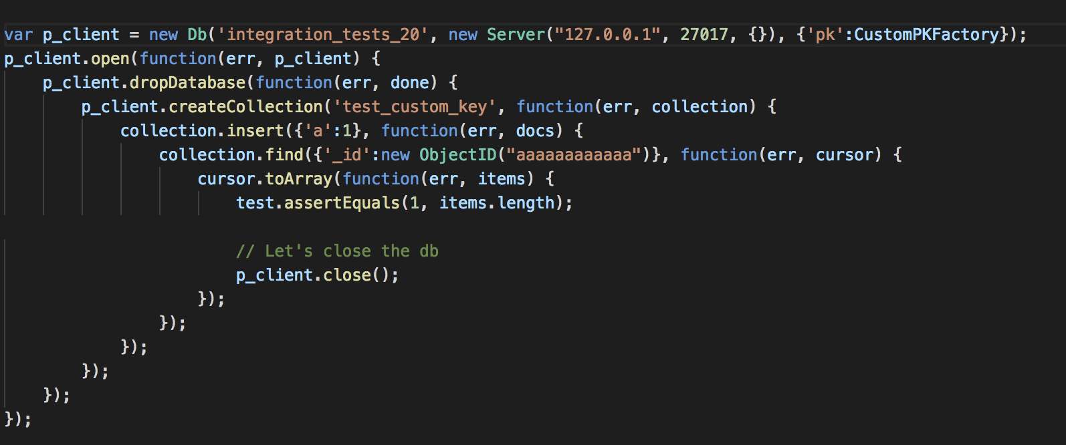
Callback hell
The messy code shown is called callback hell because of the difficulty of following the code due to the many callbacks.
Solutions:
Use Named functions instead of anonymous functions and pass their names instead of defining anonymous functions.
Split your code into separate modules, then import that module into your larger application.

Slide 8
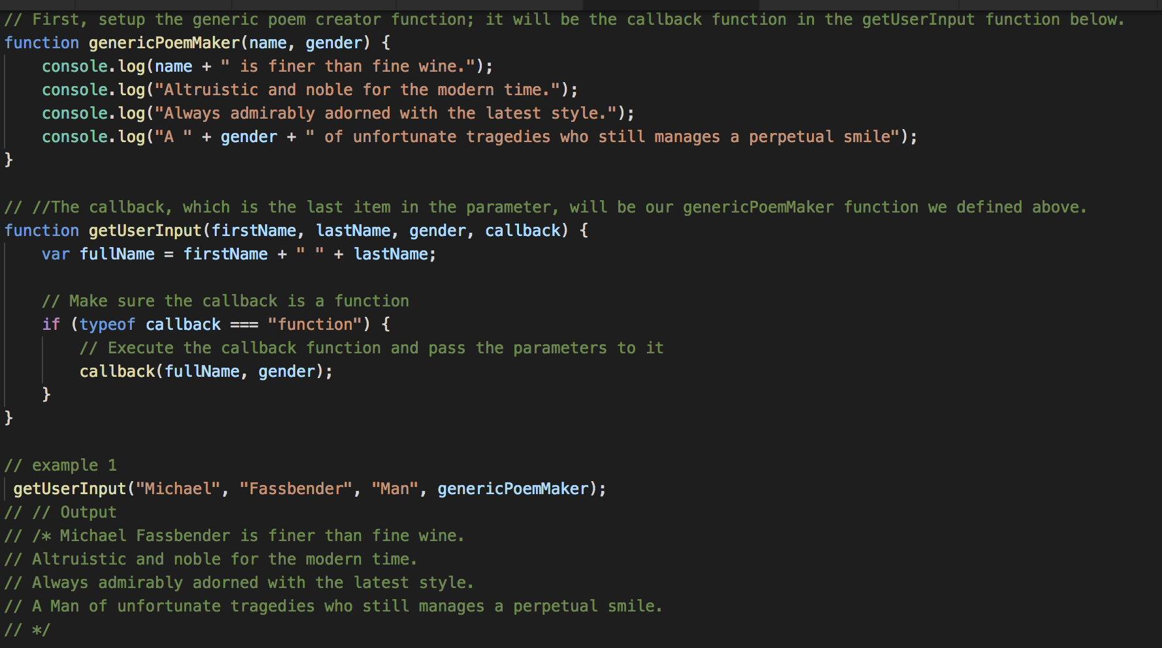
Callback
Our getUserInput is versatile it means we can pass all sorts of inputs lets see this example.

Slide 9
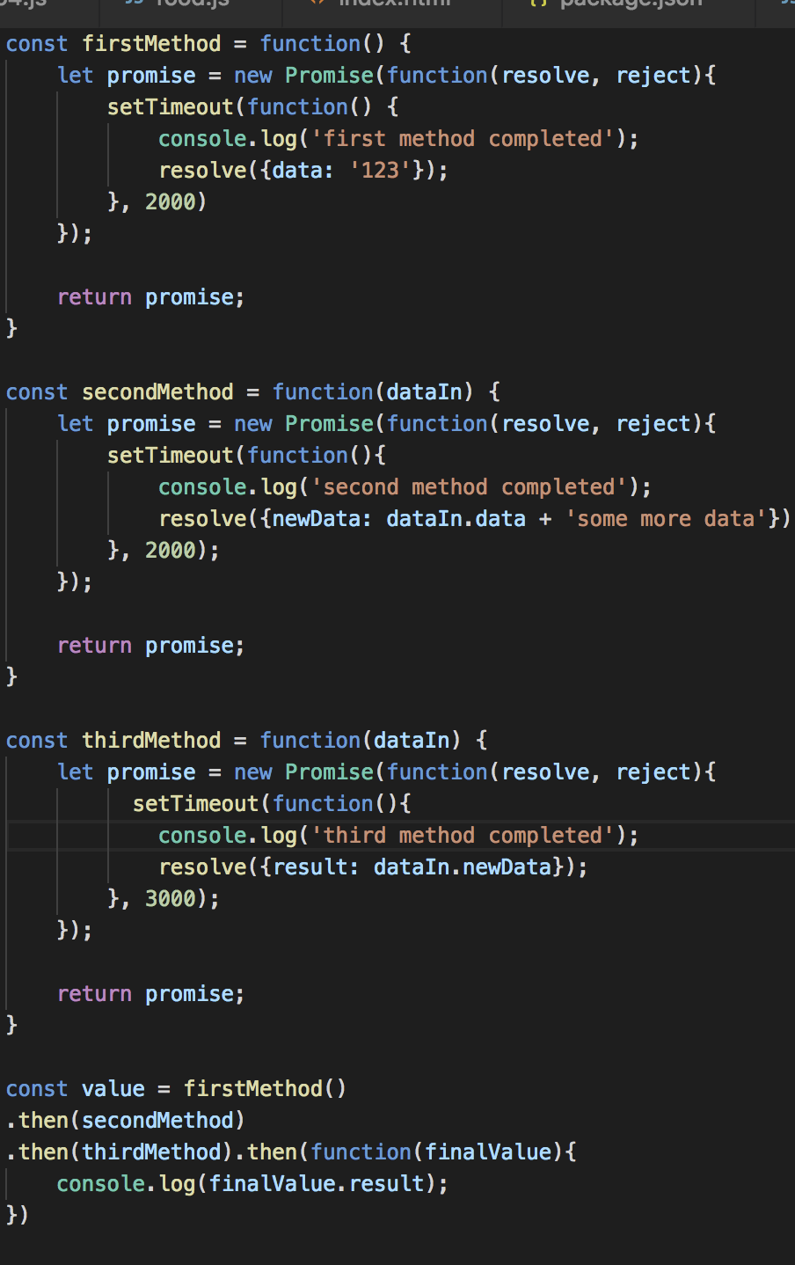
Promises
A promise is a special kind of javascript object which contains another object. I could have a promise for the integer 17, or the string “hello world”, or some arbitrary object, or anything else you would normally store in a javascript variable.
How do I access a promise, I use the word then!
As you can see it is better than callbacks it much cleaner and you can avoid the callback hell.

Slide 10
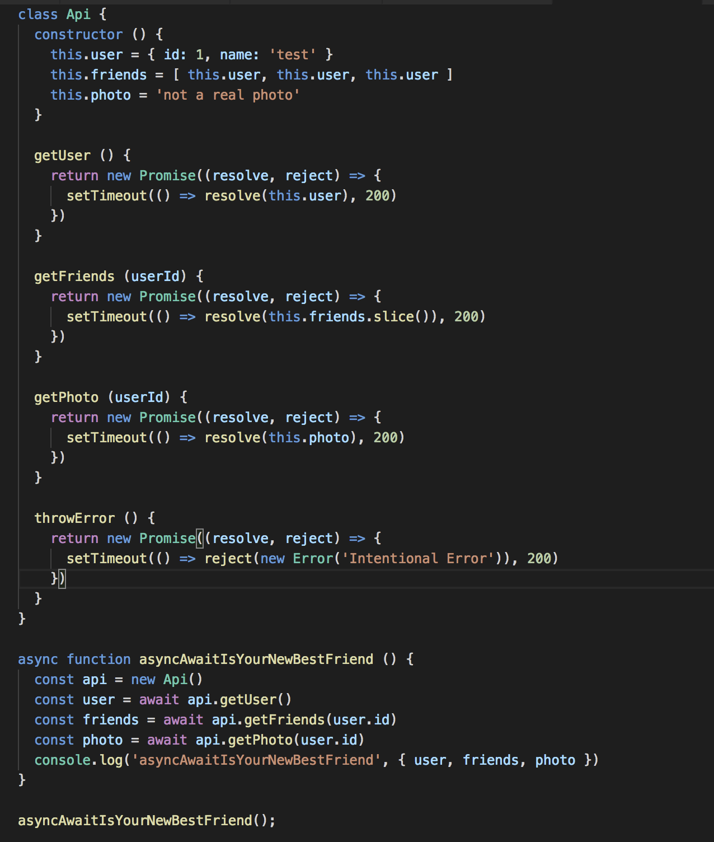
Async/Wait
Calling "await" in front of a promise pauses the flow of the function until the promise has resolved, and assigns the result to the variable to the left of the equal sign.
This way we can program an asynchronous operation flow as though it were a normal synchronous series of commands.
Notes:
https://blog.patricktriest.com/what-is-async-await-why-should-you-care/
https://javascript.info/async-await

Slide 11
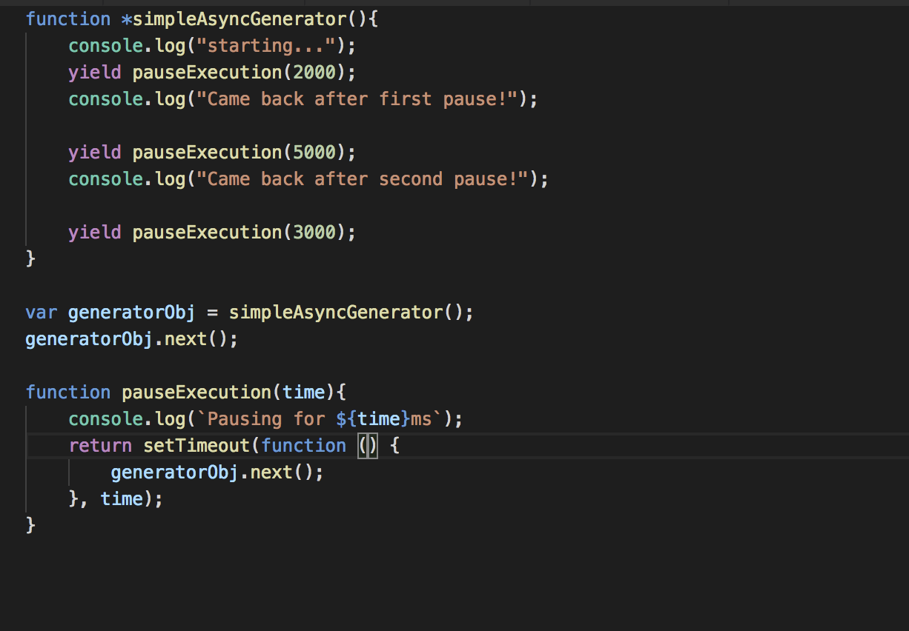
Generators
Generators are used to make objects of classes iterable.
They can also be used to create functions or methods that return iterable objects.
Notes:
http://www.dotnetcurry.com/javascript/1131/ecmascript6-async-using-generators-promises

